Slide 1
Ruckley Estate
The home of Simulated Game Shooting
Proudly Hosting:
Friday, 19th September 2025
Ruckley Estate
Shifnal
Shropshire
TF11 8PQ
Tel: 07368550403
featherlessdays
ammoshack

Slide 2
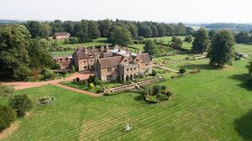
RUCKLEY GRANGE SHIFNAL, STAFFORDSHIRE Ruckley Grange is the one of the premier simulated game venues in the UK. Set in the stunning 3,500 acre Ruckley Grange Estate in Staffordshire, the shoot boats a variety of targets designed to mimic different quarry types and the use of real drives means the Guns are well spaced to enjoy a fantastic range of shooting. The day makes use of the superb purpose-built shoot lodge for breakfast, coffee and a fully catered lunch at the end of the day. ammoshack.uk/ruckley-grange

Slide 3
* £600 per person (based on 20 Guns) excluding cartridges*
8.30 | Arrive at The Gun Room. Start the day with a delicious breakfast while enjoying the company of fellow guns and guests. Following this, there will be a safety talk to ensure everyone's well-being, accompanied by a detailed briefing outlining the day’s events.
9.15 | Pegs are drawn, and the excitement begins as we head out to the first drive of the day. Guests will enjoy two additional drives throughout the morning, ensuring a lively and engaging start to the event.
ELEVENSS’S | A little something to toast the day before diving back into the action—it’s hard to go wrong with Champagne’s elegance, the cozy warmth of Sloe Gin, or even a refreshing lighter option. Cheers to a fantastic afternoon ahead! 🥂
12.30 | The afternoon unfolds with several more drives, featuring impressive representations of Grouse, Argentinian Dove, Corvid, Pheasant, and Partridge. Among these are three sponsored drives by cartridge manufacturers Fiocchi, Lyalvale Express, and Baschieri & Pellagri who will be supplying cratridge for these drives. The day reaches its pinnacle with the breathtaking Duck Drive at Monks Pool on Lady's Walk. With the final shots taken, the shooting draws to a close, leaving participants with lasting memories of an extraordinary experience.
16.30 | Guns and guests make their way back to The Gun Room to unwind and enjoy a delightful evening meal accompanied by drinks. It's the perfect way to round off the day, reflecting on the memorable experiences shared including a chat with Charity Patron and Rugby legend Mike Tindall MBE.
18.00 | Guests depart at their leisure, bringing a relaxed close to a remarkable day filled with camaraderie, thrilling drives, and unforgettable moments.
To reserve your place at this exclusive event please contact:
Simon Bailey: simon.b@rugbyforheroes.org.uk / 07732 681156
Featherless Days: featherlessdays@icloud.com / 07368 550403

Slide 4
A FEATHERLESS DAY
Experience the Thrill of Simulated Game Shooting
Simulated game shooting is exactly what it sounds like—a thrilling day shooting at clay pigeons designed to replicate the experience of traditional game shooting, but without live quarry. It’s an exciting and inclusive sport that everyone can enjoy, even those who may not participate in live game shooting but still wish to experience the camaraderie and challenge it offers.
Many of us are drawn to game shooting for its blend of stunning scenery, great company, and the satisfaction of testing our skills. Simulated game shooting captures all these elements, along with the added bonus of typically warmer and drier weather!
Clay targets bring another advantage—they make simulated game days more cost-effective than traditional game shoots while guaranteeing plenty of action. That means you’ll enjoy an incredible day filled with excitement, without worrying about a quiet shoot.
Perfect for entertaining friends or meeting new ones, simulated game shooting features a variety of drives throughout the day, including pheasants, partridge, grouse, duck, Argentinian dove, and pigeon flighting. The schedule closely mirrors a traditional game day, offering a true-to-life experience with all the fun and none of the compromise.
Join us and discover why simulated game shooting is a brilliant way to test your skills, enjoy superb company, and create lasting memories.
Tel: 07368550403
featherlessdays
ammoshack

Slide 5
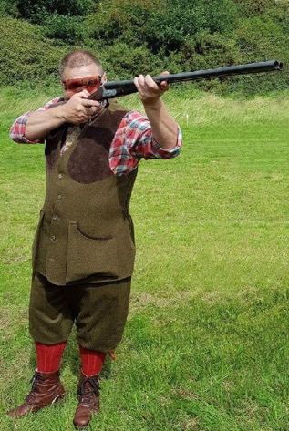
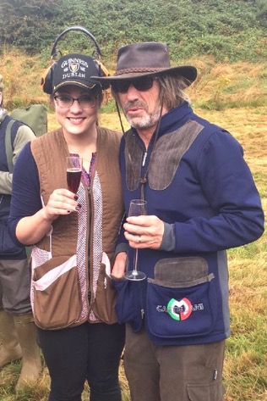
Dress Code for the Day
We are often asked if the dress code should follow that of a ‘Traditional Formal Day.’ While formal attire isn’t a requirement, it’s always welcomed and undeniably adds an elegant touch to the occasion.
That said, we kindly ask all attendees to dress smartly and suitably for the outdoors. As some drives take place in woodland areas and others in open fields, appropriate footwear is essential. Trainers or standard shoes may not offer sufficient support or grip—boots or wellingtons are by far the best choice for comfort and practicality.
We can’t wait to see everyone looking sharp and ready to enjoy a truly memorable day!
Essential Information for the Day
As the day’s activities will primarily take place outdoors, we recommend bringing along suitable clothing to ensure comfort in case of inclement weather. Staying prepared will help you make the most of the experience.
Since you’ll be shooting at clay pigeons, which produce shards, safety is our top priority. We strongly encourage and advise all participants to wear appropriate protective gear, including eye and ear protection, throughout the day.
Let’s work together to make it a safe, enjoyable, and unforgettable experience for all!
Tel: 07368550403
featherlessdays
ammoshack

Slide 6
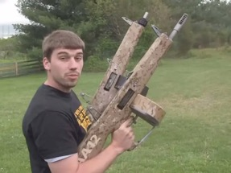
GUNS
Shotgun Guidelines for Featherless Days
Only shotguns are permitted to be fired during our Featherless Days.
Gauge: A maximum gauge of 12 is allowed, with no minimum gauge restriction.
Types of Shotguns: All forms and types of shotguns are welcome, including:
Side-by-Side
Over-and-Under
Semi-Automatic (limited to loading no more than two cartridges at a time).
These guidelines ensure a safe and enjoyable experience for all participants.
.
Tel: 07368550403
featherlessdays
ammoshack

Slide 7
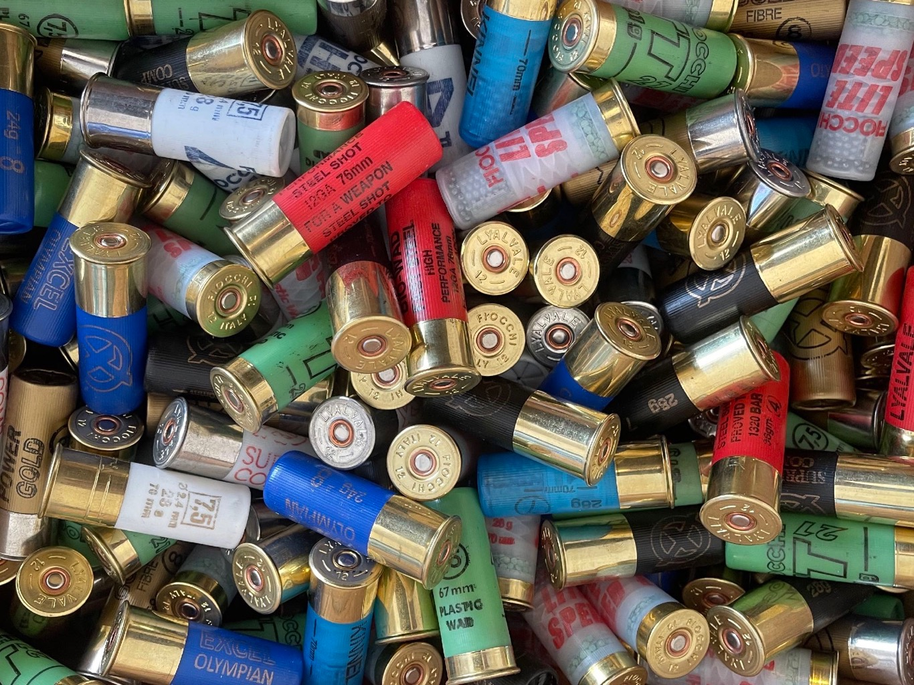
CARTRIDGES
Cartridge Information
Wads: Only fibre or Greencore wads are permitted on the estate.
Supplying Cartridges: Guns are welcome to bring their own cartridges. For those who prefer not to, we offer a pre-order service.
For those new to our Simulated Days, we recommend each gun supply or order a minimum of 500 cartridges for the day.
Ammunition Guidelines: Given the amount of shooting involved, we suggest using 21g, 24g and a maximum of 28g cartridges. However, this is simply a guideline, and the final choice is at the discretion of each shooter.
If you pre-order cartridges through us, they will be delivered directly to the shoot and ready for you to use on the day.
To place your order, simply email featherlessdays with your requirements. We also offer a wide variety of other cartridges if you’re looking for something outside our recommendations.
.
Tel: 07368550403
featherlessdays
ammoshack

Slide 8
DIRECTIONS
https://w3w.co/efficient.fussed.blessing
Meeting at the Shoot Lodge at 09:00 sharp.
We highly recommend using the what3words links, but if you prefer, here are the directions:
Using the TF11 8PQ postcode:
Approaching via Stanton Road from the A41, ignore the Timlet Lodge entrance (marked by dogs on the walls) and continue following the lane with the sandstone wall on your right.
Proceed until you reach New Lodge (marked by lions on the walls). Refer to the picture of New Lodge above and right.
Follow the drive with the reddish/pink gravel until you reach the iron gates with a green sign displaying "The Generating House."
Bear left, and the Shoot Lodge is ahead of you.
For those travelling via A41 from Cosford:
Travel along Neachley Lane until you reach New Lodge (marked by lions on the walls) on the left.
Then follow the directions above.
Tel: 07368550403
featherlessdays
ammoshack

Slide 9
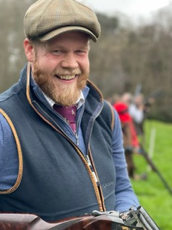
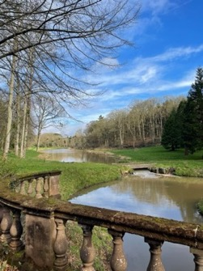
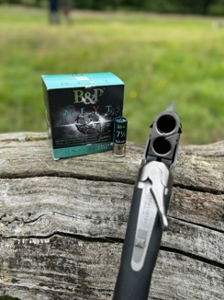
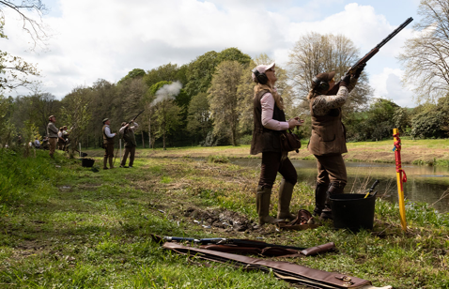
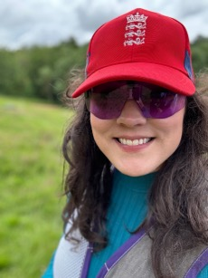
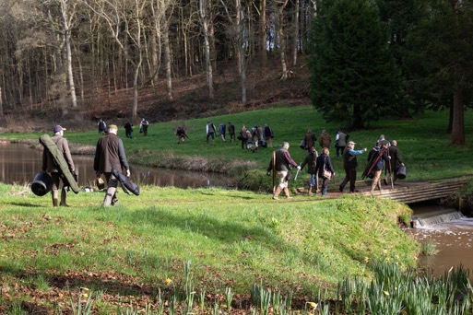
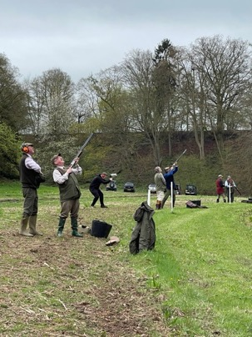
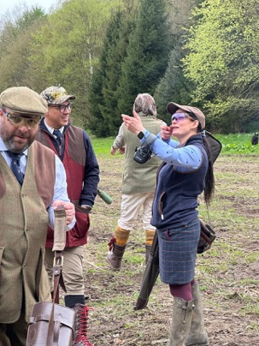
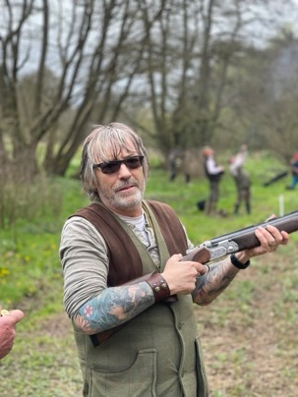
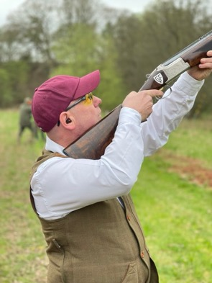
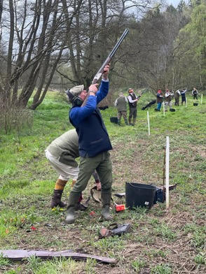
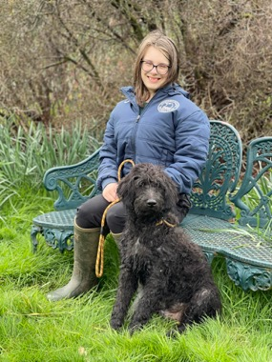
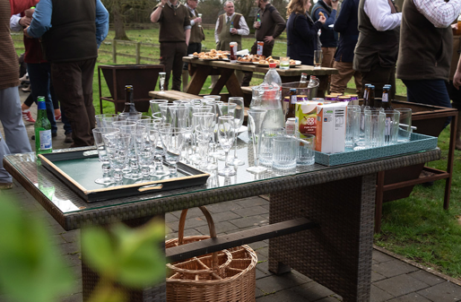
Tel: 07368550403
featherlessdays
ammoshack

